Slide 1


Slide 2
Agenda
Unit Testing in Jasmine
Jasmine Configuration
Unit testing in Angular –
Components,
Pipes and Services
DOM Interactions,
Routing and Code Coverage

Slide 3
What is Testing?
In order to accomplish a sophisticated testing toolset, you might have to address the following test types for your application.
Unit Test:
A unit test examines each small piece of your code. You may think of it as testing primitive components in their life cycles. This is often the simplest and least expensive testing option.
Integration Test:
If you have lots of composed components, you may want to test how they interact with each other. You can do this by mocking your endpoints as part of an integration test. This can be costlier and more complex than unit testing.
End-to-end Test (E2E Test):
When it comes time to test the whole system with real data to see whether everything works as expected, end-to-end testing is your best bet.

Slide 4
Testing Libraries
Jest
Jasmine
React-testing-library
Enzyme
Cypress
Puppeteer
Protractor

Slide 5
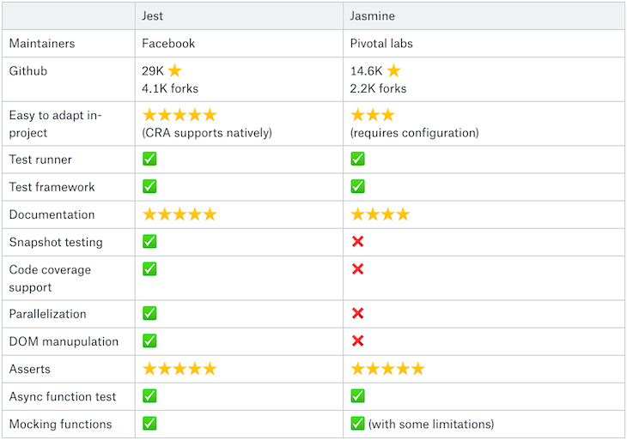
Jest & Jasmine

Slide 6
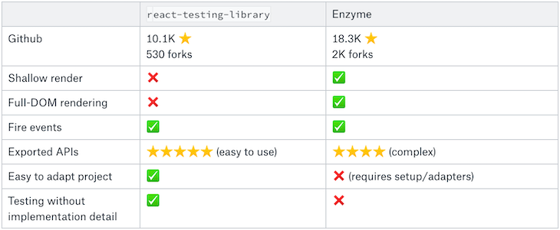
React-testing-library vs Enzyme

Slide 7
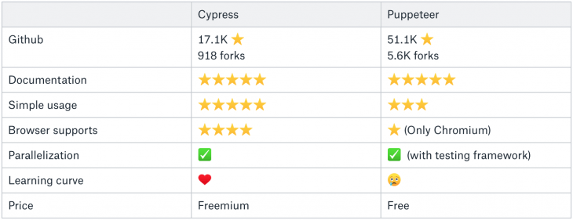
Cypress - Puppeteer

Slide 8
What is JEST?
Jest is a testing framework created and maintained by Facebook. If you build your React application with create-react-app, you can start using Jest with zero config. Just add react-test-renderer and @testing-library/react library to conduct snapshot and DOM testing.
Jest is the testing framework used at Facebook to test React components and is adopted by Uber, Airbnb and other teams.
The React community, therefore, recommends Jest as the React testing framework of choice.
With over 16M downloads a week, Jest is probably the most popular testing framework for React.

Slide 9
Summary
As you can see, each testing method, library, and framework brings its own advantages and shortfalls
Depending on the use case and types of data you wish to analyze you can choose framework
react-testing-library is the most valuable and logical choice for unit and integration tests.
JEST & ENZYME combination meets most features to test your app as per the community forums

Slide 10


Slide 11
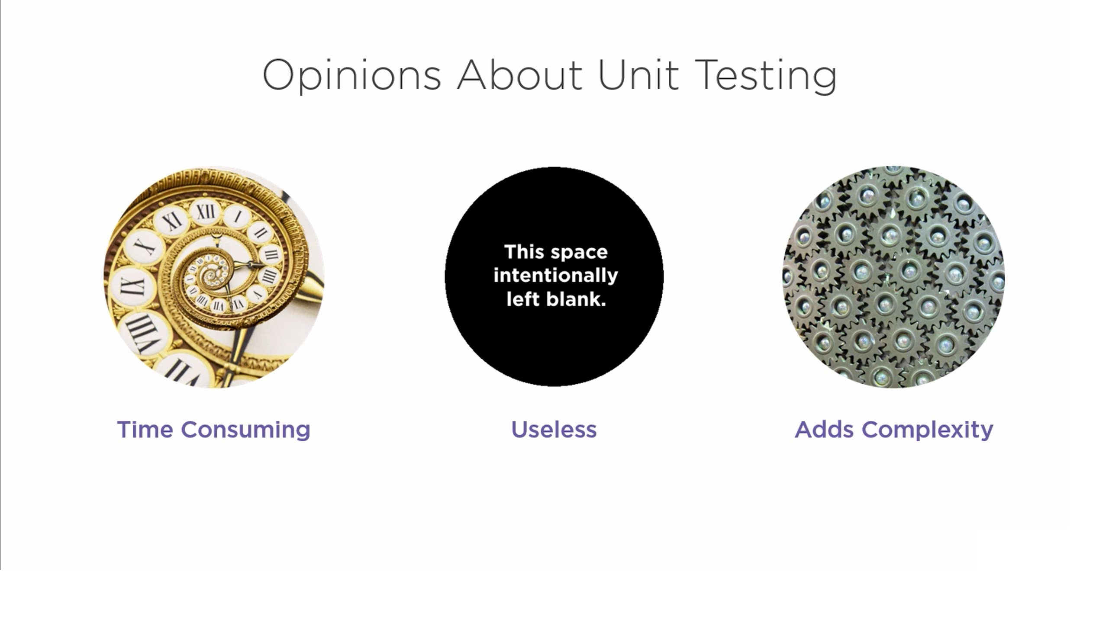

Slide 12
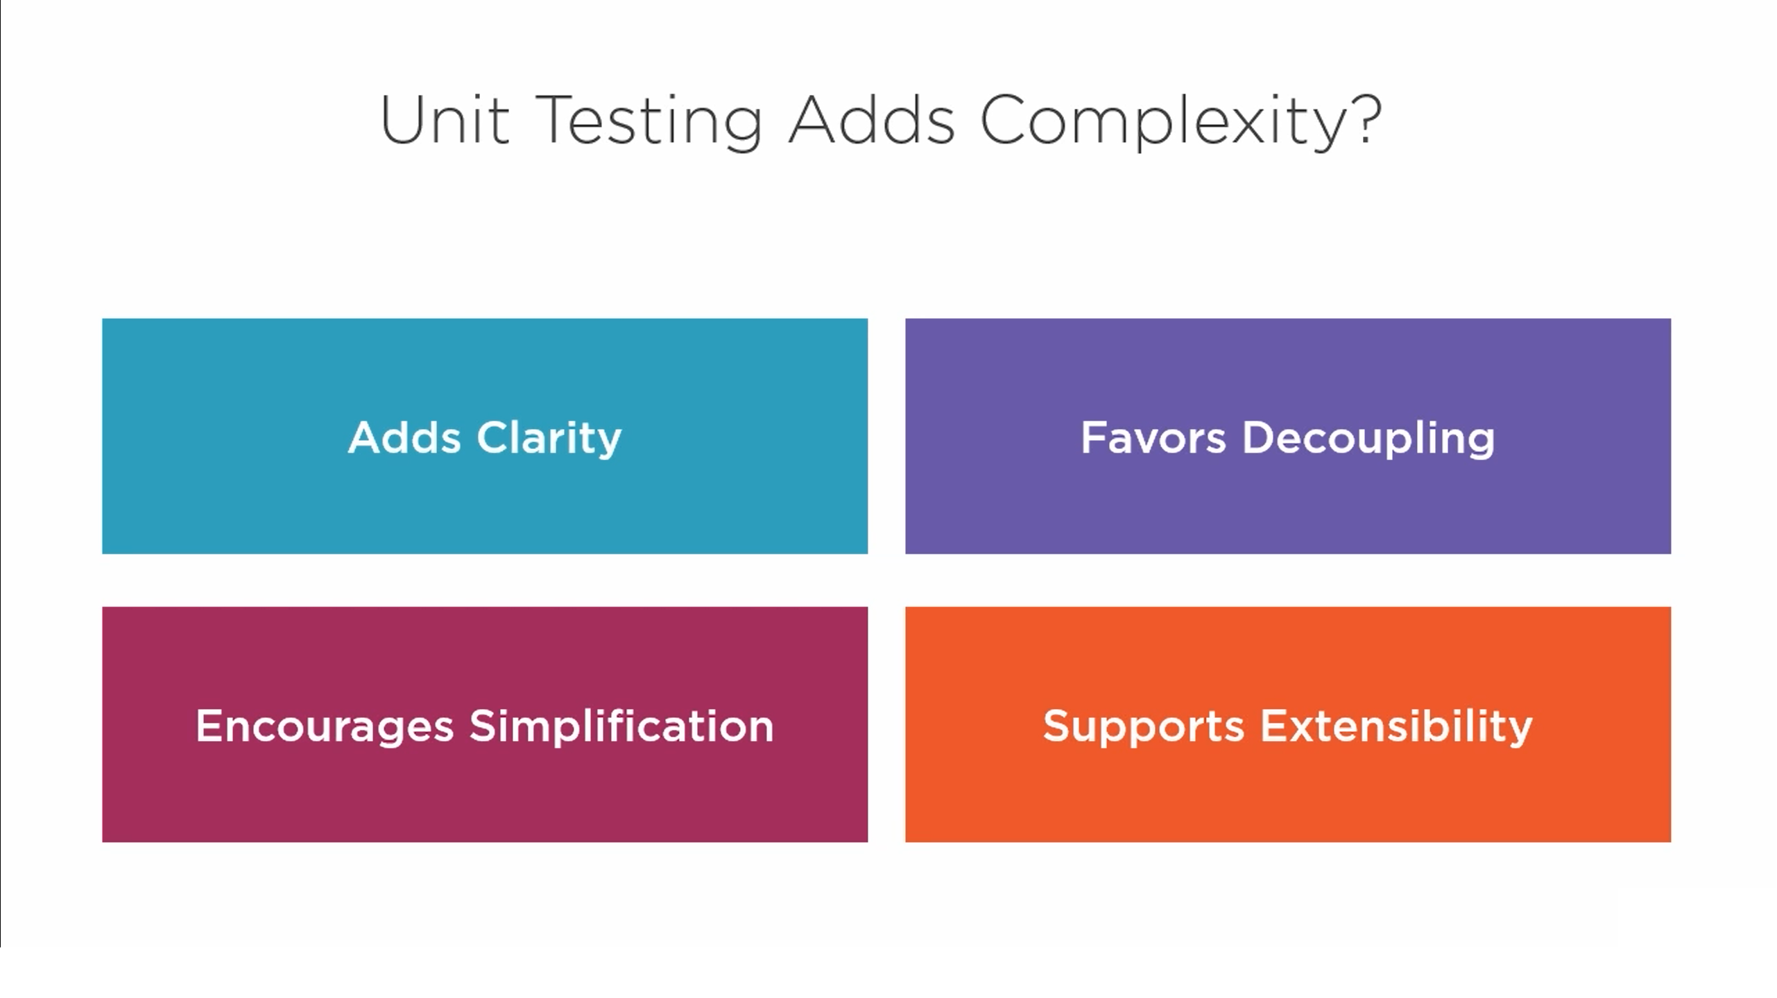

Slide 13
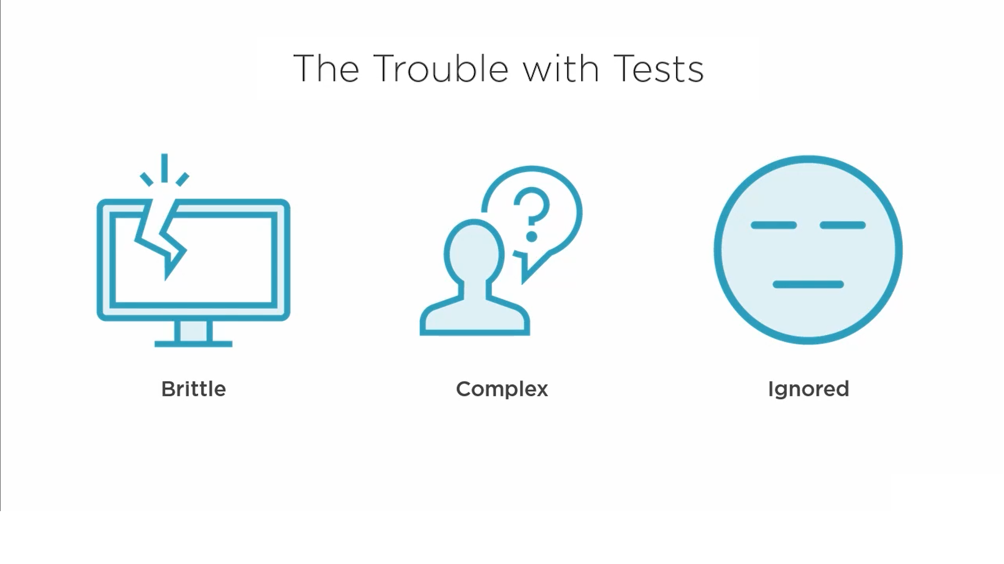

Slide 14
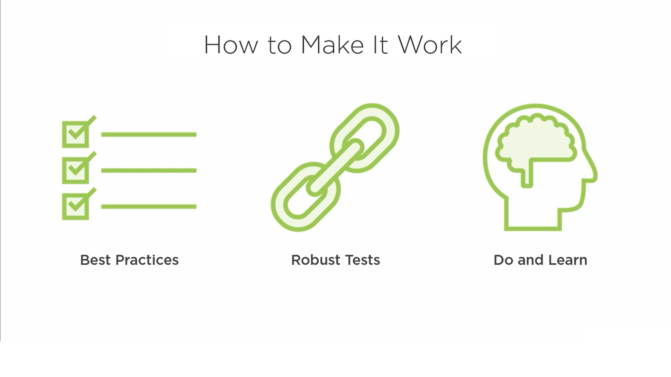

Slide 15
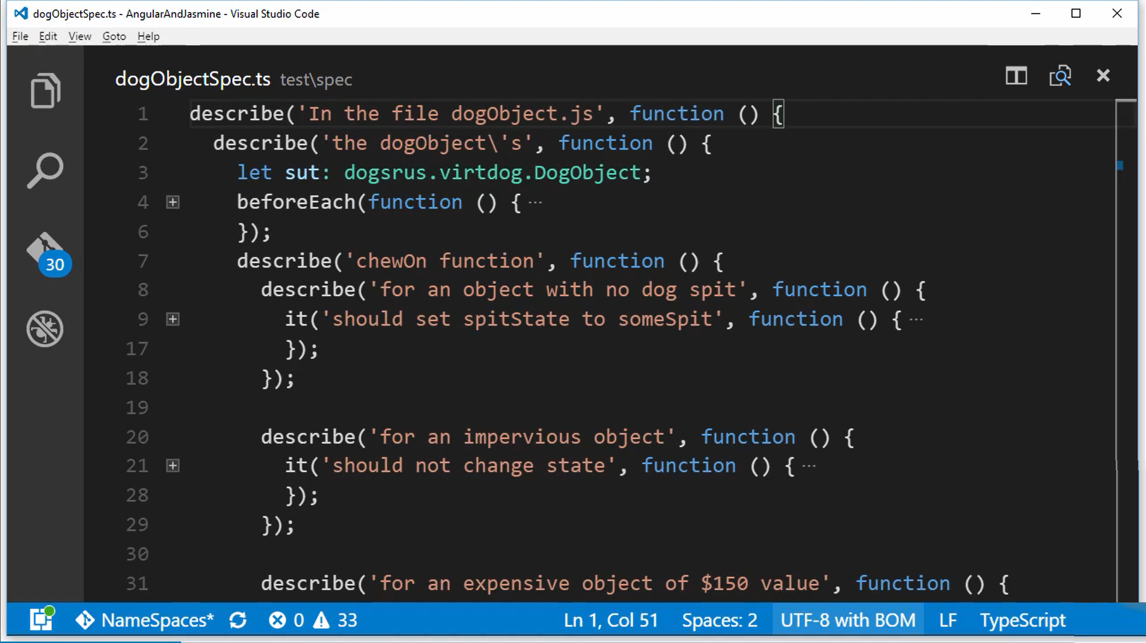

Slide 16
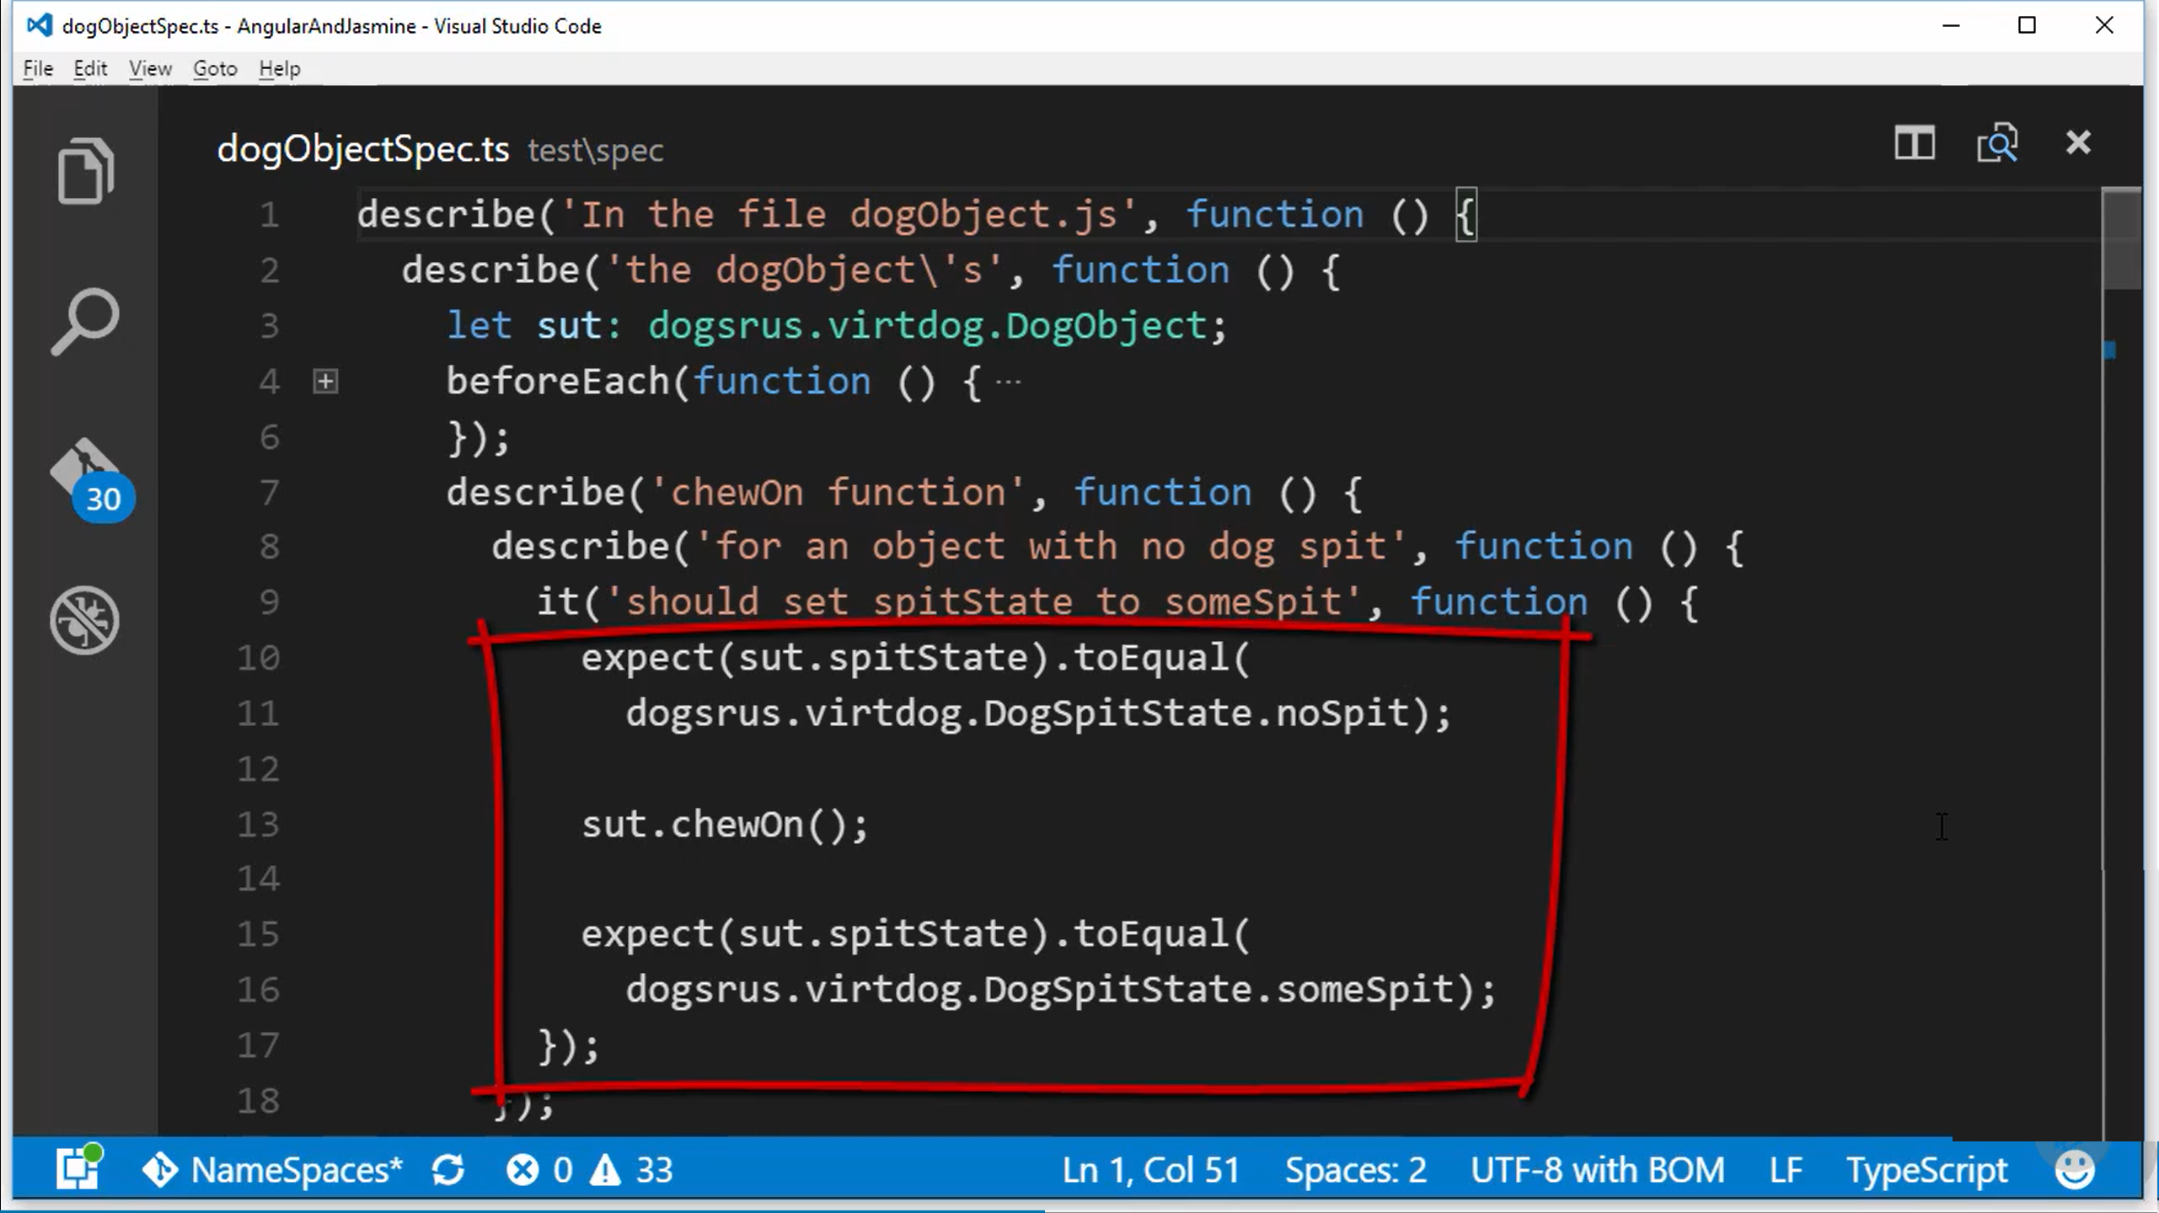

Slide 17
